Slide 1
Camera collision detection Overview
Bindu karki
2020/03/24

Slide 2
Camera
Renders views to users
A scene can have unlimited number of cameras
Multiple cameras can be used to make a single view, or can be set to render in any order, at any place on the screen, or only certain parts of the screen.
Cameras can be used in two mode: Perspective and Orthographic

Slide 3
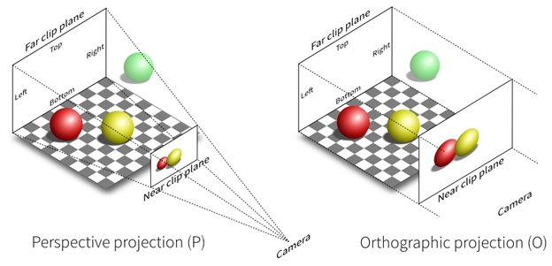
Perspective vs orthographic
Perspective
Orthographic
Mostly used for 3D games
Has diminishing perspective
Width of the view is determined by Field of view property
Most used in 2D games and to render UI
Doesn’t have diminishing perspective
Width of the view is determined by size property

Slide 4
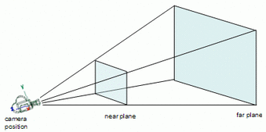
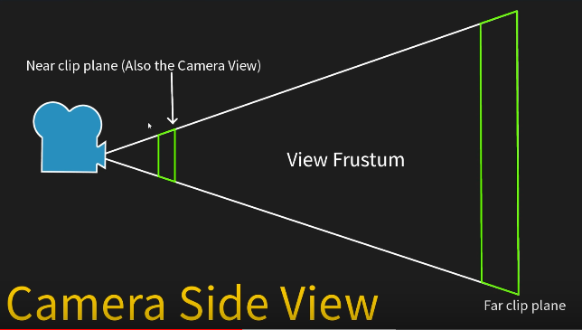
Camera and its perspective view
Acts as real world camera
Views can be adjusted using near and
far clipping planes
View Frustum
Camera Position

Slide 5
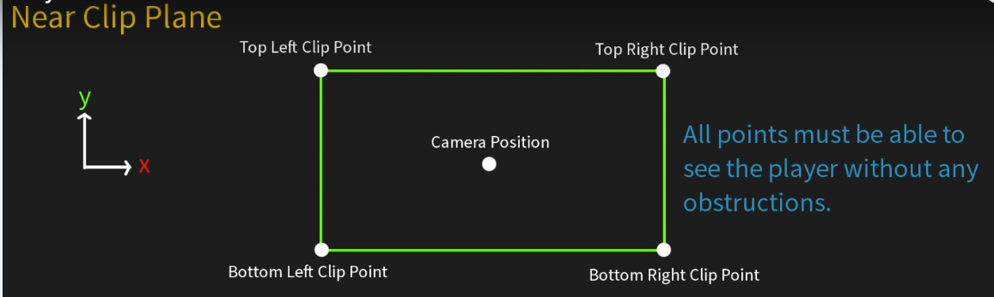
5 points For collision detection
Take near clip plane
In forward position, all five points; 4 on near clip plane and one camera position needs to be able to see the player without any obstruction
In obstruction at any point, it is determined as collision
Near Clip plane back view towards camera

Slide 6
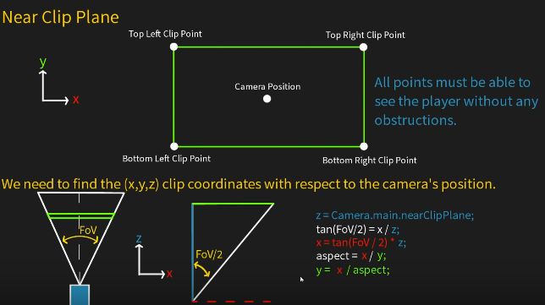
Determining x, y, z
x, y, z are the values to be used to determine clip points from camera position
z = Camera.main.nearClipPlane;
x = tan(field of view/2) * x;
y = x / aspect ratio of camera;
x
z
camera
Top View of Camera and View frustum

Slide 7
Determining 5 points in near clip plane
B
E : Camera position
A : Top left clip point given by: E + (-x, y, z)
B : Top right clip point given by: E + (x, y, z)
C : Bottom right clip point given by: E + (x, -y, z)
D : Bottom left clip point given by: E + (-x, -y, z)
A
Y
E
X
D
C
Near Clip plane back view towards camera

Slide 8
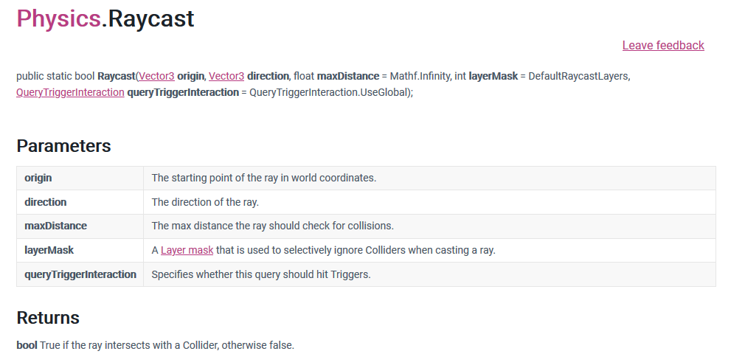
Collision detection
Once the clipping points are determined, cast ray from those points and also from the camera position to the target
If all casted ray hits the target then there is no collision else there is collision, and hence the camera is moved (forward) to the position where the target is in view.

Slide 9
Why 5 points?
Wall
B
Empty Space
Say if ray is casted from camera position only and few part of the wall falls on the camera view then it will not be taken as collision which is not realistic.
A
E
D
C
Camera View Near Clip plane

Slide 10
reference
https://www.youtube.com/watch?v=MkbovxhwM4I&list=PLUOI0wRTeX_RdsKEzZbZs_GqWXek09HDZ&index=2

